Slide 1
Birth Asphyxia
Reproductive Health Module
University of Kelaniya
June 2018
Dr. Ranmali Rodrigo
Department of Paediatrics

Slide 2
Objectives – Birth Asphyxia
Definition
Aetiology
Pathophysiology
Clinical features and prognosis
Management

Slide 3
Definition
Perinatal asphyxia, hypoxic ischaemic encephalopathy, neonatal encephalopathy used interchangeably.
Medical condition resulting from deprivation of oxygen to a newborn infant that causes physical harm, mainly to the brain
No current international consensus
  ICD, AAP, Cooling trials
Clinical management wise definition
  Evidence of a hypoxic event: AND
  Clinical evidence of encephalopathy: seizures / moderate to severe encephalopathy

Slide 4
Definition (Cont)
International Classification of Diseases (ICD)– 10
  P21.0 Severe birth asphyxia (White asphyxia)
    Pulse < 100 / min at birth and falling or steady,
    respiration absent or gasping,
    colour poor
    tone absent
    Asphyxia with 1-minute Apgar score 0-3
  P21.1 Mild and moderate birth asphyxia (Blue asphyxia)
    Normal respiration not established within one minute
    heart rate ≥100/min
    some muscle tone present
    some response to stimulation.
    Asphyxia with 1-minute Apgar score 4-7

Slide 5
Objectives – Birth Asphyxia
Definition
Aetiology
Pathophysiology
Clinical features and prognosis
Management

Slide 6
Aetiology
Maternal blood O₂ saturation
Placental blood flow
Gas exchange across placenta
O₂ delivery from placenta to fetal tissues

Slide 7

Causes
Maternal
  hypoxia (respiratory / cardiovascular)
  hypotension
  infections
  vascular disease
Placental
  insufficiency
  infarction
  abruption
  pregnancy induced hypertension

Slide 8
Causes
Cord
  accidents- prolapse, entanglement, true knot, compression
  abnormal umbilical vessels
Fetal
  anaemia
  Intra uterine growth restriction
  post maturity
  infections

Slide 9
Objectives – Birth Asphyxia
Definition
Aetiology
Pathophysiology
Clinical features and prognosis
Management

Slide 10
Pathophysiology
Tissue hypoxia
Acidosis
Myocardial depression
Bradycardia
Hypotension
Cardiac output
Failure to perfuse vital organs
Permanent tissue damage

Slide 11
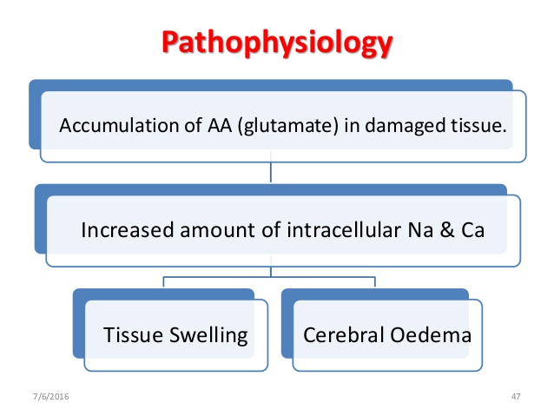
Pathophysiology
Accumulation of excitatory and toxic amino acids (glutamate) in the damaged tissue
Increased production of free radicals and NO in damaged tissue

Slide 12
Pathophysiology
Blood pressure drops
compensatory mechanisms
change blood flow to,
  maintain oxygen delivery to
  vital organs - brain, heart, adrenals
  reduced blood flow to
  gut, liver, kidneys, skin

Slide 13

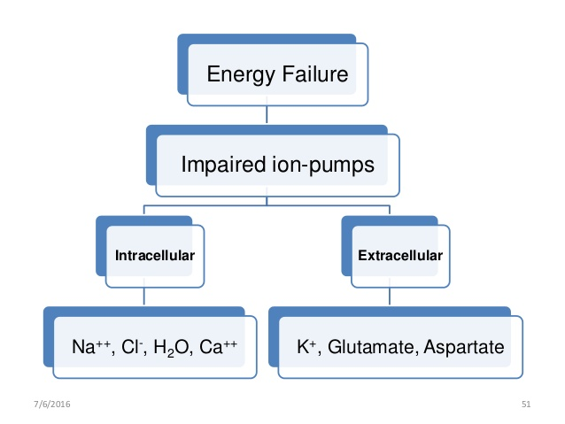
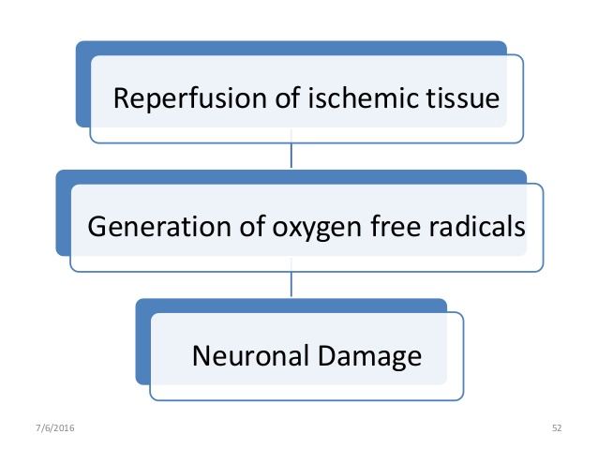
Pathophysiology

Slide 14
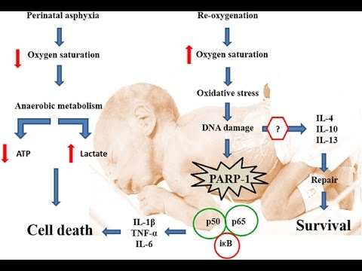

Slide 15
Objectives – Birth Asphyxia
Definition
Aetiology
Pathophysiology
Clinical features and prognosis
Management

Slide 16
Features of hypoxia in the fetus
Clinical features of fetal distress
  bradycardia
  meconium stained liquor
  Reduced fetal movements
CTG
  Decelerations (late)
  Reduced variablity
Blood sampling for acidosis
  Fetal scalp blood sampling
  Cord blood just after delivery

Slide 17
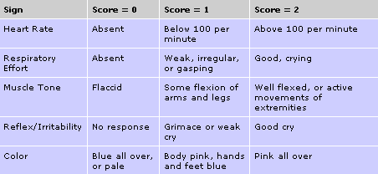
APGAR score

Slide 18
APGAR – long term outcome
APGAR scores have poor sensitivity as a predictor of asphyxia - esp at 1 minute
APGAR score < 5 at 10 minutes in terms of predicting long term major problems:
  sensitivity of 57%; specificity of 95%
Notes:
In respect to APGAR score
worth noting that 75% of children with CP have APGAR score of 7-10 at 5 minutes

Slide 19
Clinical manifestations
Hypoxic ischaemic encephalopathy (HIE)
Multi-organ system
Fluid /electrolyte : fluid overload, hyperkalaemia, hypoglycaemia, metabolic acidosis.

Slide 20
Clinical manifestations & prognosis
Sarnat staging of HIE
Prolonged encephalopathy (>6 days) more severe neurodisability
Stage | Clinical Features | Prognosis
Stage 1 (Grade 1) | Increased irritability, hyper-alertness, no seizures | <1.5% long-term developmental delay or death
Stage 2 (Grade 2) | Lethargy, seizures | 20% significant neuro-disability
Stage 3 (Grade 3) | Stupor, Flaccid, absent reflexes, Seizures (maybe mainly electrical) | 75% risk of dying as a neonate almost universal risk of sequalae among survivors

Slide 21
Clinical manifestations (details)
Effects of asphyxia on different organ systems:
Central nervous system: Hypoxic-ischemic encephalopathy, infarction, intracranial hemorrhage, seizures, cerebral edema, hypotonia
Cardiovascular system: Myocardial ischemia, poor contractility, hypotension.
Pulmonary System: Pulmonary hypertension, pulmonary haemorrhage, respiratory distress syndrome
Renal System: Acute tubular or cortical necrosis.
Adrenal glands: Adrenal haemorrhage
Gastrointestinal: Perforation, ulceration + haemorrhage, necrosis
Metabolic: SIADH, hyponatremia, hypoglycemia, hypocalcemia
Integument: Subcutaneous fat necrosis
Haematology: Disseminated intravascular coagulation.

Slide 22
Consequences of perinatal asphyxia
Fetal demise
Neonatal death or a
Period of recovery during which there is organ dysfunction with possible long-term effects, particularly in neurological function

Slide 23
Other prognostic factors
EEG abnormality:
Nuclear magnetic resonance
MRI and spectroscopy provide information on brain structure
and function that is highly predictive of outcome.
Cranial ultrasound scan
Notes:
Cranial ultrasound scan
small or poorly visualised ventricles, and hypoechogenicities are at increased risk of abnormal neurodevelopment

Slide 24
Objectives – Birth Asphyxia
Definition
Aetiology
Pathophysiology
Clinical features and prognosis
Management

Slide 25
Immediate management
Supportive care
  Ventilation, fluids, blood pressure, seizure control, coagulation
Therapeutic hypothermia (Cooling) – cooling reduces mortality and neuro disability among survivors.

Slide 26
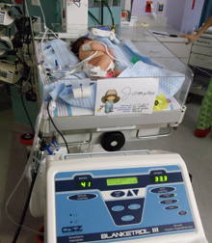
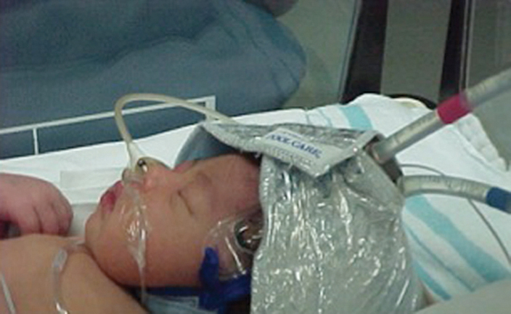
Therapeutic hypothermia
Criteria for use
Whole body / selective head
Rectal temperature 33.5°C for 72 hrs (for whole body cooling)
Cooling blanket / ice or gel packs

Slide 27
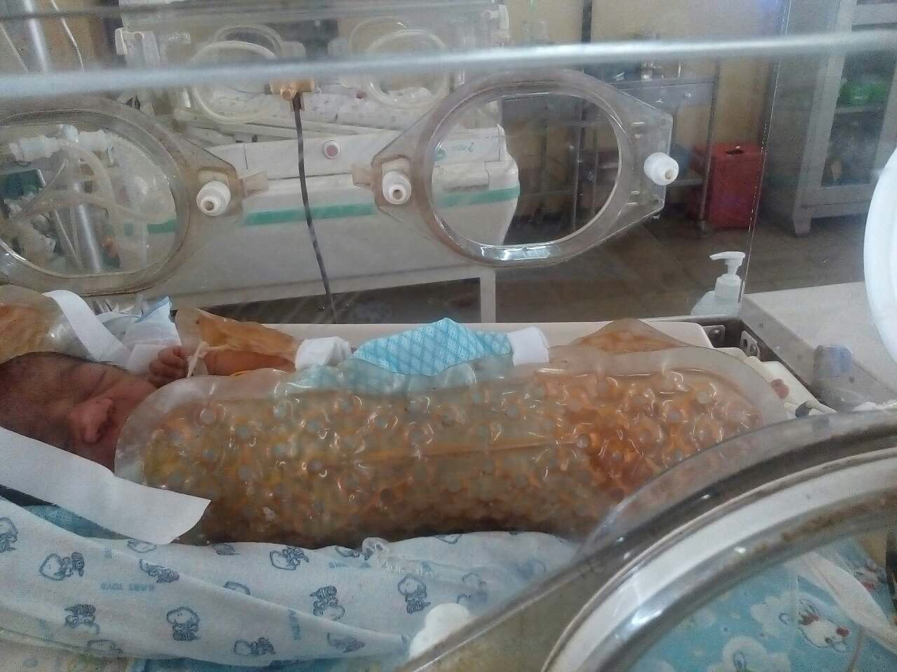
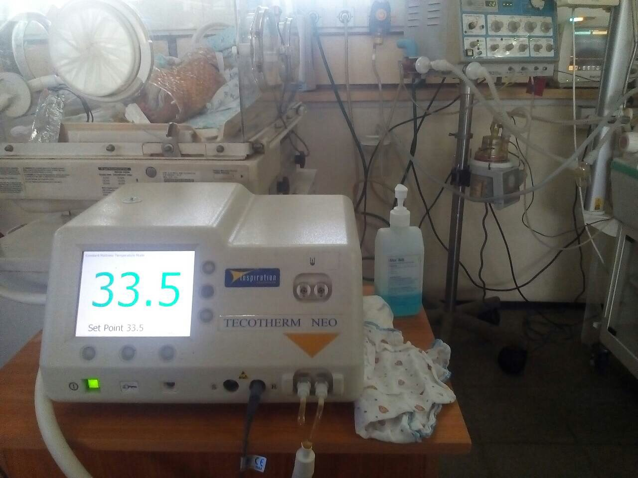

Slide 28
Follow-up
Growth parameters including OFC
Developmental assessment –all domains
Referral for early intervention
Hearing assessment and referral
Vision assessment and referral
Psychosocial well being of parents

Slide 29
QUESTIONS?

Slide 30
Summary
Definition – no consensus
Aetiology – maternal, placental, cord, fetal
Pathophysiology
Clinical features and prognosis – multi-organ effects possible; severe HIE – poor prognosis-
Management – therapeutic hypothermia, supportive care

